Slide 1
Chapter 4
How to work with numeric and string data

Slide 2
Objectives (part 1)
Applied
Given an arithmetic expression and the values for the variables in the expression, evaluate the expression.
Use numeric and string data as needed within your applications. That means you should be able to do any of the following:
declare and initialize variables and constants
code arithmetic expressions and assignment statements
use the static methods of the Math class
generate a random number
cast and convert data from one type to another
use the correct scope for your variables
declare and use enumerations
work with nullable value types and the null-coalescing operator

Slide 3
Objectives (part 2)
Knowledge
Distinguish between a variable and a constant and give the naming conventions for each.
Describe any of these data types: int, double, decimal, bool, and string.
Describe any of these terms: literal value, null value, empty string, concatenate, append, escape sequence, string literal, verbatim string literal, and nullable data type.
Describe the order of precedence for arithmetic expressions.
Distinguish between implicit casting and explicit casting.
Distinguish between a value type and a reference type.

Slide 4
Objectives (part 3)
Describe the differences in the ways that casting, the ToString() method of a data structure, the Parse() and TryParse() methods of a data structure, and the methods of the Convert class can be used to convert data from one form to another.
Describe the differences between class scope and method scope.

Slide 5
The built-in value types (part 1)
C# .NET keyword Bytes type Description
byte 1 Byte A positive integer value from 0 to 255
sbyte 1 SByte A signed integer value from -128 to 127
short 2 Int16 An integer from –32,768 to +32,767
ushort 2 UInt16 An unsigned integer from 0 to 65,535
int 4 Int32 An integer from –2,147,483,648 to +2,147,483,647
uint 4 UInt32 An unsigned integer from 0 to 4,294,967,295

Slide 6
The built-in value types (part 2)
C# .NET keyword Bytes type Description
long 8 Int64 An integer from –9,223,372,036,854,775,808 to +9,223,372,036,854,775,807
ulong 8 UInt64 An unsigned integer from 0 to +18,446,744,073,709,551,615
float 4 Single A non-integer number with approximately 7 significant digits
double 8 Double A non-integer number with approximately 14 significant digits

Slide 7
The built-in value types (part 3)
C# .NET keyword Bytes type Description
decimal 16 Decimal A non-integer number with up to 28 significant digits (integer and fraction) that can represent values up to 7.9228 x 1028
char 2 Char A single Unicode character
bool 1 Boolean A true or false value

Slide 8
How to declare and initialize a variable in two statements
Syntax
type variableName; variableName = value;
Example
int counter; counter = 1;
Description
A variable stores a value that can change as a program executes.
Naming conventions
Start the names of variables with a lowercase letter, and capitalize the first letter of each word after the first word. This is known as camel notation.
Try to use meaningful names that are easy to remember.

Slide 9
How to declare and initialize a variable in one statement
Syntax
type variableName = value;
Examples
int counter = 1;
long numberOfBytes = 2000000;
float interestRate = 8.125f;
double price = 14.95;
decimal total = 24218.1928m;
int population1 = 1734323;
int population2 = 1_734_323
double starCount = 3.65e+9;
char letter = 'A';
bool valid = false;
int x = 0, y = 0;

Slide 10
How to declare and initialize a constant
Syntax
const type ConstantName = value;
Examples
const int DaysInNovember = 30; const decimal SalesTax = .075m;
Description
A constant stores a value that can’t be changed.
Naming conventions
Capitalize the first letter of each word of a constant name. This is known as Pascal notation.
Try to use meaningful names that are easy to remember.

Slide 11
Arithmetic operators (part 1)
Operator Name Description
+ Addition Adds two operands.
- Subtraction Subtracts the right operand from the left operand.
* Multiplication Multiplies the right operand and the left operand.
/ Division Divides the right operand into the left operand. If both operands are integers, then the result is an integer.
% Modulus Returns the value that is left over after dividing the right operand into the left operand.

Slide 12
Arithmetic operators (part 2)
Operator Name Description
+ Positive sign Returns the value of the operand.
- Negative sign Changes a positive value to negative, and vice versa.
++ Increment Adds 1 to the operand (x = x + 1).
-- Decrement Subtracts 1 from the operand (x = x - 1).

Slide 13
Arithmetic expressions that use integers
int x = 14;
int y = 8;
int result1 = x + y; // result1 = 22
int result2 = x - y; // result2 = 6
int result3 = x * y; // result3 = 112
int result4 = x / y; // result4 = 1
int result5 = x % y; // result5 = 6
int result6 = -y + x; // result6 = 6
int result7 = --y; // result7 = 7, y = 7
int result8 = ++x; // result8 = 15, x = 15

Slide 14
Arithmetic expressions that use decimals
decimal a = 8.5m;
decimal b = 3.4m;
decimal result11 = a + b; // result11 = 11.9
decimal result12 = a - b; // result12 = 5.1
decimal result13 = a / b; // result13 = 2.5
decimal result14 = a * b; // result14 = 28.90
decimal result15 = a % b; // result15 = 1.7
decimal result16 = -a; // result16 = -8.5
decimal result17 = --a; // result17 = 7.5, a = 7.5
decimal result18 = ++b; // result18 = 4.4, b = 4.4

Slide 15
Assignment operators
Operator Name
= Assignment
+= Addition
-= Subtraction
*= Multiplication
/= Division
%= Modulus

Slide 16
The syntax for a simple assignment statement
variableName = expression;
Typical assignment statements
counter = 7;
newCounter = counter;
discountAmount = subtotal * .2m;
total = subtotal – discountAmount;

Slide 17
Statements that use the same variable on both sides of the equals sign
total = total + 100m;
total = total – 100m;
price = price * .8m;
Statements that use the shortcut assignment operators
total += 100m;
total -= 100m;
price *= .8m;

Slide 18
The order of precedence for arithmetic operations
Increment and decrement
Positive and negative
Multiplication, division, and modulus
Addition and subtraction

Slide 19
A calculation that uses the default order of precedence
decimal discountPercent = .2m; // 20% discount
decimal price = 100m; // $100 price
price = price * 1 – discountPercent; // price = $99.8
A calculation that uses parentheses to specify the order of precedence
decimal discountPercent = .2m; // 20% discount
decimal price = 100m; // $100 price
price = price * (1 – discountPercent); // price = $80
The use of prefixed and postfixed increment and decrement operators
int a = 5;
int b = 5;
int y = ++a; // a = 6, y = 6
int z = b++; // b = 6, z = 5

Slide 20
How implicit casting works
Casting from less precise to more precise data types
byte→short→int→long→decimal
int→double
short→float→double
char→int
Examples
double grade = 93; // convert int to double
int letter = 'A'; // convert char to int
double a = 95.0;
int b = 86, c = 91;
double average = (a+b+c)/3; // convert b and c to double values
// (average = 90.666666...)

Slide 21
How to code an explicit cast
The syntax for coding an explicit cast
(type) expression
Examples
int grade = (int)93.75; // convert double to int
// (grade = 93)
char letter = (char)65; // convert int to char
// (letter = 'A')
double a = 95.0;
int b = 86, c = 91;
int average = ((int)a+b+c)/3; // convert a to int value
// (average = 90)
decimal result = (decimal)b/(decimal)c; // result has decimal
// places

Slide 22
Five static methods of the Math class
The syntax of the Round() method
Math.Round(decimalNumber[, precision[, mode]])
The syntax of the Pow() method
Math.Pow(number, power)
The syntax of the Sqrt() method
Math.Sqrt(number)
The syntax of the Min() and Max() methods
Math.{Min|Max}(number1, number2)

Slide 23
Statements that use static methods of the Math class
int shipWeight = Math.Round(shipWeightDouble); // round to a whole number
double orderTotal = Math.Round(orderTotal, 2); // round to 2 decimal places
double area = Math.Pow(radius, 2) * Math.PI; // area of circle
double sqrtX = Math.Sqrt(x);
double maxSales = Math.Max(lastYearSales, thisYearSales);
int minQty = Math.Min(lastYearQty, thisYearQty);

Slide 24
Results from static methods of the Math class
Statement Result
Math.Round(23.75, 1) 23.8
Math.Round(23.85, 1) 23.8
Math.Round(23.744, 2) 23.74
Math.Round(23.745, 2) 23.74
Math.Round(23.745, 2, MidpointRounding.AwayFromZero) 23.75
Math.Pow(5, 2) 25
Math.Sqrt(20.25) 4.5
Math.Max(23.75, 20.25) 23.75
Math.Min(23.75, 20.25) 20.25

Slide 25
Instance methods of the Random class
Method Description
Next() Returns a random int value that is greater than or equal to 0 and less than the maximum value for the int type.
Next(maxValue) Returns a random int value that is greater than or equal to 0 and less than the specified maximum value.
Next(minValue, Returns a random int value that is greater than maxValue) or equal to the specified minimum value and less than the specified maximum value.
NextDouble() Returns a double value that is greater than or equal to 0.0 and less than 1.0.

Slide 26
A statement that creates an instance of the Random class
Random number = new Random();
Statements that use the methods of the Random class
number.Next(); // an int >= 0 and < Int32.MaxValue
number.Next(101); // an int >= 0 and < 101
number.Next(1,101); // an int >= 1 and < 101
number.NextDouble(); // a double >= 0.0 and < 1.0
Code that simulates the roll of two dice
Random number = new Random();
int die1 = number.Next(1, 7); // die1 is >= 1 and < 7
int die2 = number.Next(1, 7); // die2 is >= 1 and < 7

Slide 27
How to declare and initialize a string
string message1 = "Invalid data entry.";
string message2 = "";
string message3 = null;
How to join strings
string firstName = "Bob"; // firstName is "Bob"
string lastName = "Smith"; // lastName is "Smith"
string name = firstName + " " + lastName
// name is "Bob Smith"
How to join a string and a number
double price = 14.95;
string priceString = "Price: $" + price; // priceString is "Price: $14.95"

Slide 28
How to append one string to another string
string firstName = "Bob"; // firstName is "Bob"
string lastName = "Smith"; // lastName is "Smith"
string name = firstName + " "; // name is "Bob "
name = name + lastName; // name is "Bob Smith"
How to append one string to another with the += operator
string firstName = "Bob"; // firstName is "Bob"
string lastName = "Smith"; // lastName is "Smith"
string name = firstName + " "; // name is "Bob "
name += lastName; // name is "Bob Smith"

Slide 29
Common escape sequences
Key Description
\n New line
\t Tab
\r Return
\\ Backslash
\" Quotation

Slide 30
Examples that use escape sequences
Code Result
string code = "JSPS";
decimal price = 49.50m;
string result =
"Code: " + code + "\n" + Code: JSPS
"Price: $" + price + "\n"; Price: $49.50
string names = Joe Smith
"Joe\tSmith\rKate\tLewis\r"; Kate Lewis
string path = "c:\\c#.net\\files"; c:\c#.net\files
string message =
"Type \"x\" to exit"; Type "x" to exit

Slide 31
Examples that use verbatim string literals
Code Result
string names = @"Joe Smith Joe Smith
Kate Lewis"; Kate Lewis
string path = @"c:\c#.net\files"; c:\c#.net\files
string message =
@"Type ""x"" to exit"; Type "x" to exit

Slide 32
Common .NET structures that define value types
Structure C# keyword What the value type holds
Byte byte An 8-bit unsigned integer
Int16 short A 16-bit signed integer
Int32 int A 32-bit signed integer
Int64 long A 64-bit signed integer
Single float A single-precision floating-point number
Double double A double-precision floating-point number
Decimal decimal A 96-bit decimal value
Boolean bool A true or false value
Char char A single character

Slide 33
Common .NET classes that define reference types
Class C# keyword What the reference type holds
String string A reference to a String object
Object object A reference to any type of object

Slide 34
Common methods for data conversion
Method Description
ToString([format]) A method that converts the value to its equivalent string representation using the specified format. If the format is omitted, the value isn’t formatted.
Parse(string) A static method that converts the specified string to an equivalent data value. If the string can’t be converted, an exception occurs.
TryParse(string, result) A static method that converts the specified string to an equivalent data value and stores it in the result variable. Returns a true value if the string is converted. Otherwise, returns a false value.

Slide 35
Some of the static methods of the Convert class
Method Description
ToDecimal(value) Converts the value to the decimal data type.
ToDouble(value) Converts the value to the double data type.
ToInt32(value) Converts the value to the int data type.
ToChar(value) Converts the value to the char data type.
ToBool(value) Converts the value to the bool data type.
ToString(value) Converts the value to a string object.

Slide 36
Statements that use ToString(), Parse(), and TryParse()
decimal sales = 2574.98m;
string salesString = sales.ToString(); // decimal to string
sales = Decimal.Parse(salesString); // string to decimal
Decimal.TryParse(salesString, out sales); // string to decimal
An implicit call of the ToString() method
double price = 49.50;
string priceString = "Price: $" + price; // automatic ToString
// call
A TryParse() method that handles invalid data
string salesString = "$2574.98";
decimal sales = 0m;
Decimal.TryParse(salesString, out sales); // sales is 0

Slide 37
Conversion statements that use the Convert class
decimal subtotal = Convert.ToDecimal(txtSubtotal.Text); // string to decimal
int years = Convert.ToInt32(txtYears.Text); // string to int
txtSubtotal.Text = Convert.ToString(subtotal); // decimal to string
int subtotalInt = Convert.ToInt32(subtotal); // decimal to int

Slide 38
Standard numeric formatting codes
Code Format
C or c Currency
P or p Percent
N or n Number
F or f Float
D or d Digits
E or e Exponential
G or g General

Slide 39
How to use the ToString() method to format a number
Statement Example
string monthlyAmount = amount.ToString("c"); $1,547.20
string interestRate = interest.ToString("p1"); 2.3%
string quantityString = quantity.ToString("n0"); 15,000
string paymentString = payment.ToString("f3"); 432.818

Slide 40
How to use the Format() method of the String class to format a number
Statement Result
string monthlyAmount = String.Format("{0:c}", 1547.2m); $1,547.20
string interestRate = String.Format("{0:p1}", .023m); 2.3%
string quantityString = String.Format("{0:n0}", 15000); 15,000
string paymentString = String.Format("{0:f3}", 432.8175); 432.818
The syntax of the format specification used by the Format() method
{index:formatCode}

Slide 41
Code that declares and uses variables with class scope
public frmInvoiceTotal()
{
InitializeComponent();
}
decimal numberOfInvoices = 0m;
decimal totalOfInvoices = 0m;
private void btnCalculate_Click(object sender, EventArgs e)
{
decimal subtotal = Convert.ToDecimal(txtEnterSubtotal.Text);
decimal discountPercent = .25m;
decimal discountAmount = subtotal * discountPercent;
decimal invoiceTotal = subtotal - discountAmount;
numberOfInvoices++;
totalOfInvoices += invoiceTotal;
// the rest of the code for the method
}
private void btnClearTotals_Click(object sender, EventArgs e)
{
numberOfInvoices = 0m;
totalOfInvoices = 0m;
}

Slide 42
How to work with scope
The scope of a variable determines what code has access to it. If you try to refer to a variable outside of its scope, it will cause a build error.
The scope of a variable is determined by where you declare it. If you declare a variable within a method, it has method scope. If you declare a variable within a class but not within a method, it has class scope.
A variable with method scope can only be referred to by statements within that method. A variable with class scope can be referred to by all of the methods in the class.
The lifetime of a variable is the period of time that it’s available for use. A variable with method scope is only available while the method is executing. A variable with class scope is available while the class is instantiated.

Slide 43
Some of the constants in the FormBorderStyle enumeration
Constant Description
FormBorderStyle.FixedDialog A fixed, thick border typically used for dialog boxes
FormBorderStyle.FixedSingle A single-line border that isn’t resizable
FormBorderStyle.Sizable A resizable border
A statement that uses the FormBorderStyle enumeration
this.FormBorderStyle = FormBorderStyle.FixedSingle;

Slide 44
The syntax for declaring an enumeration
enum EnumerationName [: type]
{
ConstantName1 [= value][,
ConstantName2 [= value]]...
}

Slide 45
An enumeration that sets the constant values to 0, 1, and 2
enum Terms
{
Net30Days,
Net60Days,
Net90Days
}
An enumeration that sets the constant values to 30, 60, and 90
enum TermValues : short
{
Net30Days = 30,
Net60Days = 60,
Net90Days = 90
}

Slide 46
Statements that use these enumerations
Terms t = Terms.Net30Days;
int i = (int) Terms.Net30Days; // i is 0
int i = (int) TermValues.Net60Days; // i is 60
string s = Terms.Net30Days.ToString(); // s is "Net30Days"

Slide 47
How to declare a value type that can contain null values
int? quantity;
quantity = null;
quantity = 0;
quantity = 20;
decimal? salesTotal = null;
Terms? paymentTerm = null;
// string? Message = null; // not necessary or allowed // by default

Slide 48
Two properties for working with nullable value types
Property Description
HasValue Returns a true value if the nullable type contains a value. Returns a false value if the nullable type is null.
Value Returns the value of the nullable type.
How to use the properties of a nullable value type
if (quantity.HasValue) {
int qty = quantity.Value;
}

Slide 49
How to use the null-coalescing operator to assign a default value
int qty = quantity ?? -1;
How to use the null-coalescing assignment operator
salesTotal ??= 0.0m;
How to use nullable value types in arithmetic expressions
decimal? sales1 = 3267.58m;
decimal? sales2 = null;
decimal? salesTotal = sales1 + sales2; // result = null

Slide 50
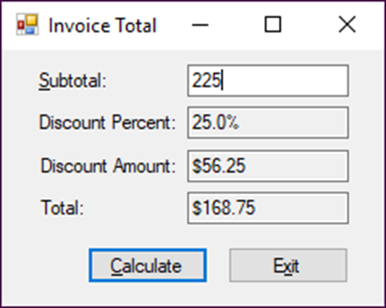
The Invoice Total form

Slide 51
The controls that are referred to in the code
Object type Name Description
TextBox txtSubtotal A text box that accepts a subtotal amount
TextBox txtDiscountPercent A read-only text box that displays the discount percent
TextBox txtDiscountAmount A read-only text box that displays the discount amount
TextBox txtTotal A read-only text box that displays the invoice total
Button btnCalculate Calculates the discount amount and invoice total when clicked
Button btnExit Closes the form when clicked

Slide 52
The event handlers for the Invoice Total form
private void btnCalculate_Click(object sender, EventArgs e)
{
decimal subtotal = Convert.ToDecimal(txtSubtotal.Text);
decimal discountPercent = .25m;
decimal discountAmount = subtotal * discountPercent;
decimal invoiceTotal = subtotal - discountAmount;
txtDiscountPercent.Text = discountPercent.ToString("p1");
txtDiscountAmount.Text = discountAmount.ToString("c");
txtTotal.Text = invoiceTotal.ToString("c");
txtSubtotal.Focus();
}
private void btnExit_Click(object sender, EventArgs e)
{
this.Close();
}

Slide 53
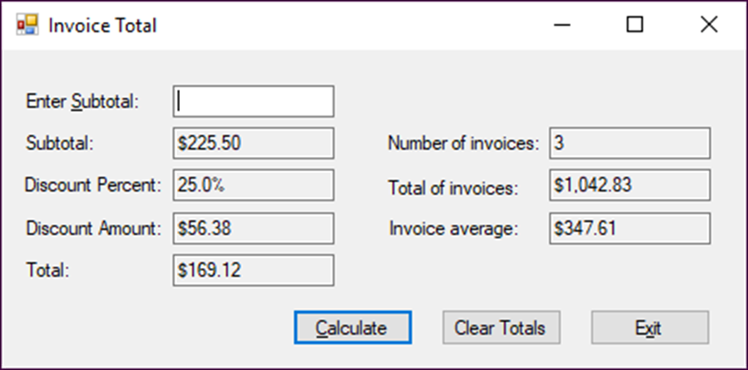
The enhanced Invoice Total form

Slide 54
The code for the class variables and two event handlers (part 1)
int numberOfInvoices = 0;
decimal totalOfInvoices = 0m;
decimal invoiceAverage = 0m;
private void btnCalculate_Click(object sender, EventArgs e)
{
decimal subtotal = Convert.ToDecimal(txtEnterSubtotal.Text);
decimal discountPercent = .25m;
decimal discountAmount =
Math.Round(subtotal * discountPercent, 2);
decimal invoiceTotal = subtotal - discountAmount;
txtSubtotal.Text = subtotal.ToString("c");
txtDiscountPercent.Text = discountPercent.ToString("p1");
txtDiscountAmount.Text = discountAmount.ToString("c");
txtTotal.Text = invoiceTotal.ToString("c");
numberOfInvoices++;
totalOfInvoices += invoiceTotal;
invoiceAverage = totalOfInvoices / numberOfInvoices;

Slide 55
The code for the class variables and two event handlers (part 2)
txtNumberOfInvoices.Text = numberOfInvoices.ToString();
txtTotalOfInvoices.Text = totalOfInvoices.ToString("c");
txtInvoiceAverage.Text = invoiceAverage.ToString("c");
txtEnterSubtotal.Text = "";
txtEnterSubtotal.Focus();
}
private void btnClearTotals_Click(object sender,
System.EventArgs e)
{
numberOfInvoices = 0;
totalOfInvoices = 0m;
invoiceAverage = 0m;
txtNumberOfInvoices.Text = "";
txtTotalOfInvoices.Text = "";
txtInvoiceAverage.Text = "";
txtEnterSubtotal.Focus();
}

Slide 56
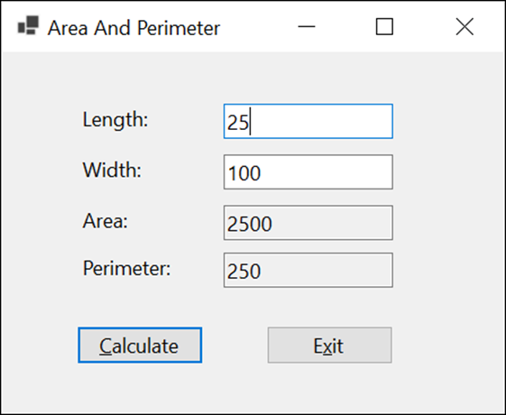
Extra 4-1 Calculate area and perimeter
Accept the length and width of a rectangle and calculate the area and perimeter.

Slide 57
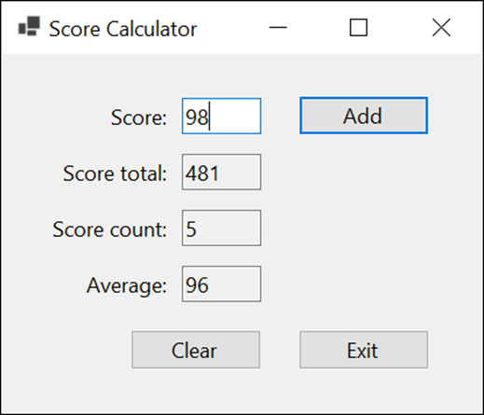
Extra 4-2 Accumulate test score data
Accept one or more scores and calculate the score total, score count, and average score.

Slide 58
Objectives (part 1)
Applied
Given an arithmetic expression and the values for the variables in the expression, evaluate the expression.
Use numeric and string data as needed within your applications. That means you should be able to do any of the following:
declare and initialize variables and constants
code arithmetic expressions and assignment statements
use the static methods of the Math class
generate a random number
cast and convert data from one type to another
use the correct scope for your variables
declare and use enumerations
work with nullable value types and the null-coalescing operator

Slide 59
Objectives (part 2)
Knowledge
Distinguish between a variable and a constant and give the naming conventions for each.
Describe any of these data types: int, double, decimal, bool, and string.
Describe any of these terms: literal value, null value, empty string, concatenate, append, escape sequence, string literal, verbatim string literal, and nullable data type.
Describe the order of precedence for arithmetic expressions.
Distinguish between implicit casting and explicit casting.
Distinguish between a value type and a reference type.

Slide 60
Objectives (part 3)
Describe the differences in the ways that casting, the ToString() method of a data structure, the Parse() and TryParse() methods of a data structure, and the methods of the Convert class can be used to convert data from one form to another.
Describe the differences between class scope and method scope.

